Slide 1

SMOKING DETECTION SYSTEM BASED ON IMAGE PROCESSING WITH
DEEP LEARNING AND CLOUD COMPUTING
Ahmet Nezih KASIM
Utku DEMIR
Aziz HAN
08.02.2021
Notes:
<number>

Slide 2

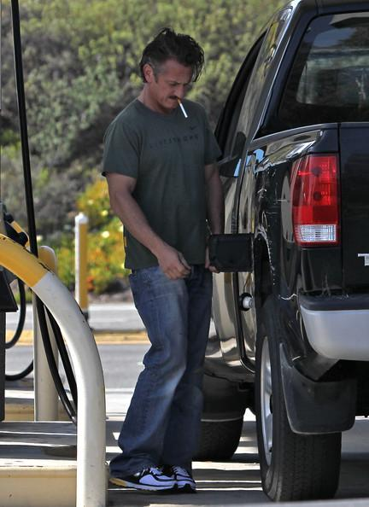

PROBLEM & PURPOSE OF THE PROJECT
Smoking ban violation
Controlling smoking consumption bus stops and gas stations
Aimed to follow the smoking bans in an automated way.
Providing the Municipalities and Police with ease of ban follow

Slide 3
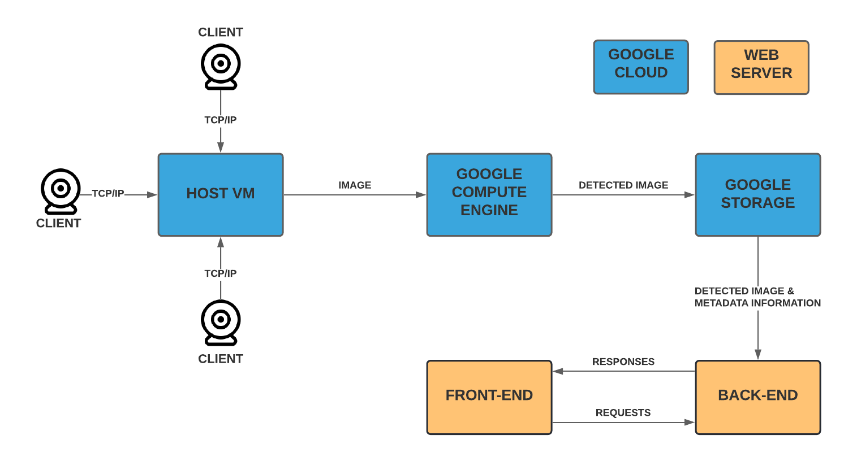
PROJECT ARCHITECTURE

Slide 4
PREPARING THE SYSTEM
Preliminaries
Preparing Dataset
Training the Object Detection Algorithms
Image Transfer
Cloud Computing
Web Server

Slide 5
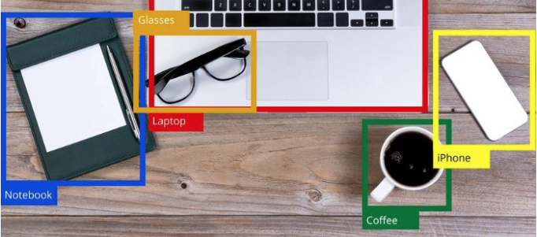
OBJECT DETECTION
Computer vision technique
Used to identify and locate objects of certain classes
Machine learning and deep learning based methods
Used in many areas

Slide 6
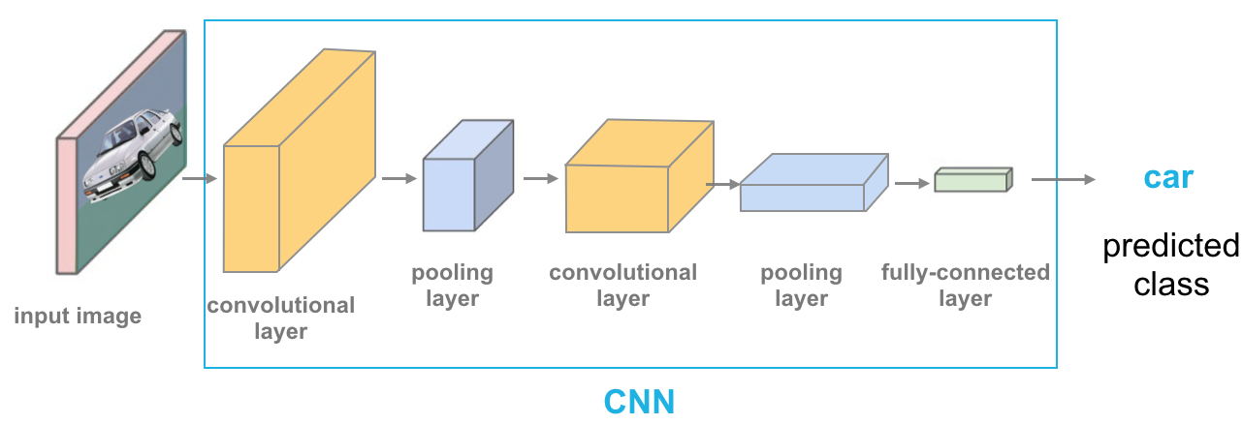
OBJECT DETECTION
Convolutional Neural Network (CNN)
Algorithm used to recognize patterns in image
Applying a convolution operation to one of the layers
An object detection algorithm

Slide 7
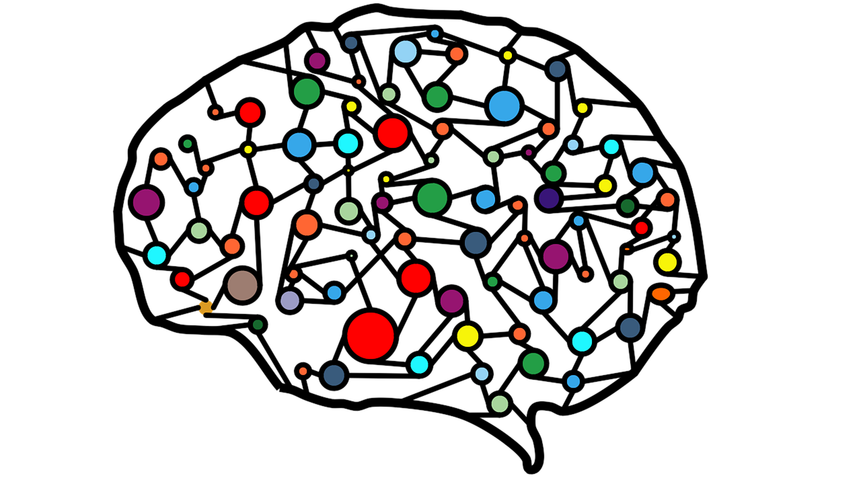
OBJECT DETECTION
CNN
Successful in classification
Takes an input, assign importance and differentiate
Similar to architecture of brain

Slide 8
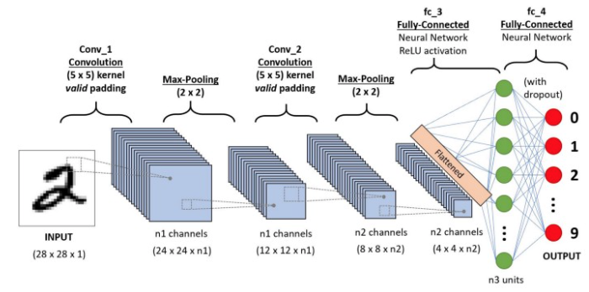
OBJECT DETECTION
CNN
Convolution, pooling and fully connected layers
Extracting features from input in convolution layer
Reducing the computation in pooling layer
Connecting neurons in different layers in fully connected layer

Slide 9
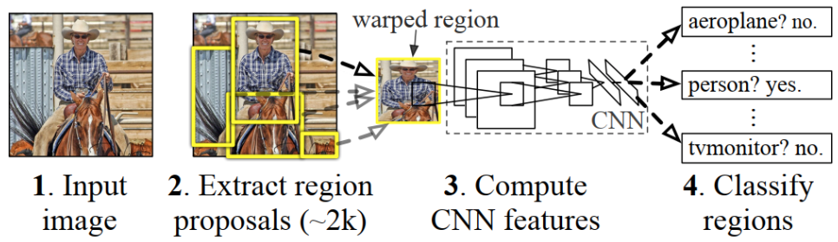
OBJECT DETECTION
Region-based CNN (R-CNN)
Segments the image to find bounding boxes
Finds the most likely objects in bounding boxes
Fast R-CNN, Faster R-CNN, Mask R-CNN, SSD, YOLO

Slide 10
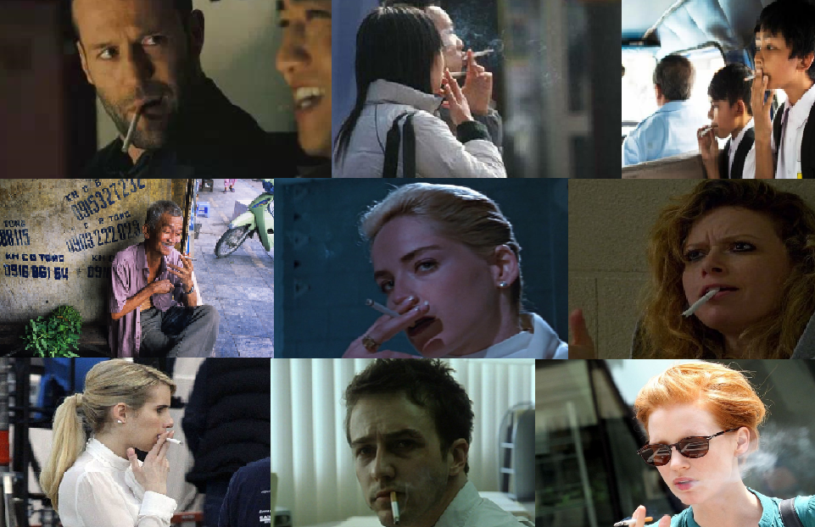
DATA COLLECTION
Kaggle as starting point
Collection from the search engines (i.e. Google, Yandex) through Python
- Keywords: Cigarette, smoking
1500 images after elimination
Data augmentation process
A duplicate with geometric transformations (scaling, rotating, flipping, cropping, etc.)
<number>

Slide 11
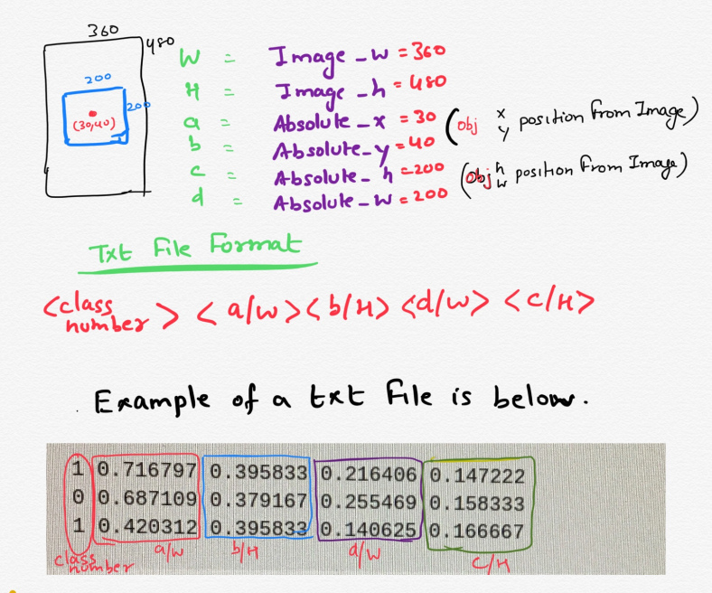
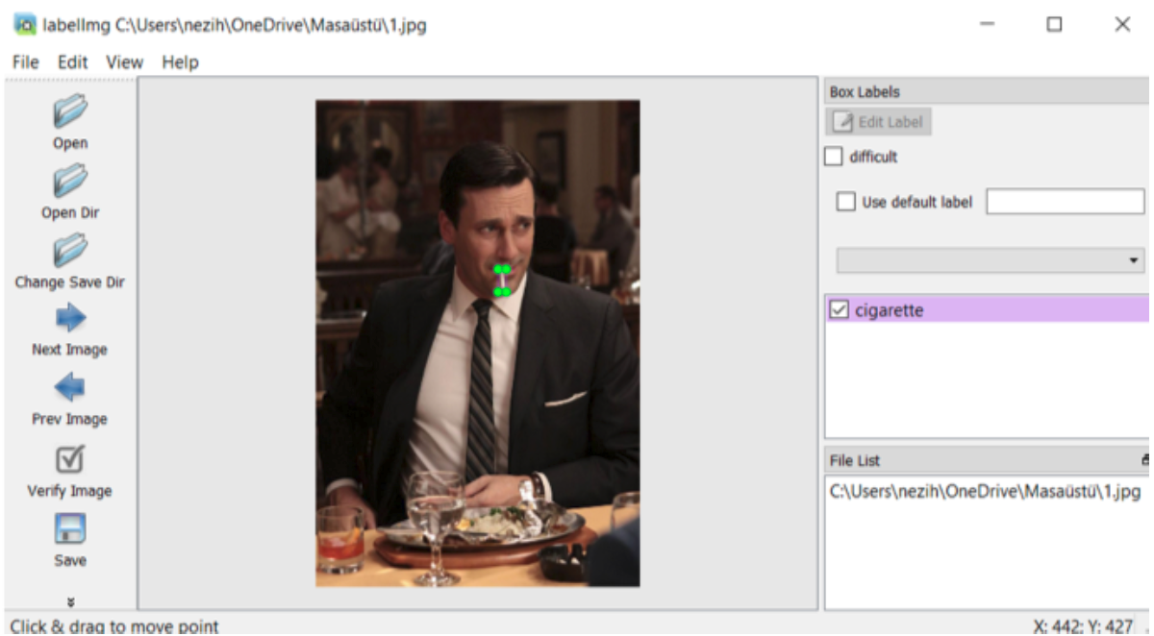
DATA LABELING
1500 images to annotate – before the augmentation
YOLO annotation format in Darknet framework
Image annotation tool: LabelImg (Tzutalin , 2015)
<number>

Slide 12
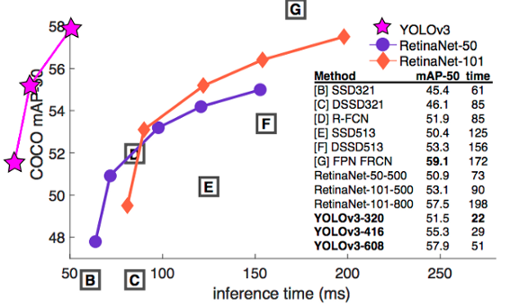
MODEL SELECTION
Needing a good performance in detecting small objects (cigarettes)
Fast, accurate, robust YOLOv3 on darknet (C/C++)
COCO-50 Benchmark of Different Alternative Classifiers
<number>
Notes:
<number>

Slide 13
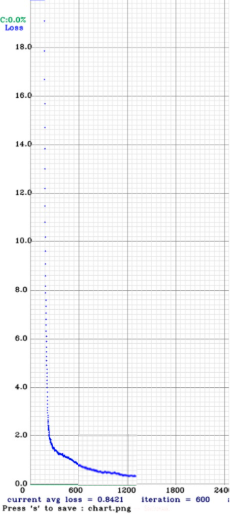
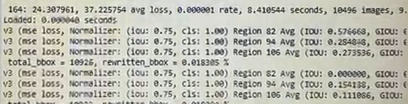
MODEL TRAINING
On darknet framework through Colab
Binary classifier (Cigarette or not)
90% Training image – 10% Test image
darknet53.conv.74 as pretrained model
150 Epochs
Screenshot from Training Process
The Loss Graph
<number>
Notes:
<number>

Slide 14
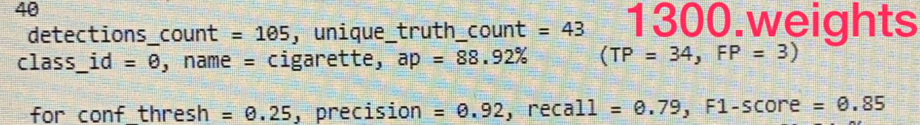
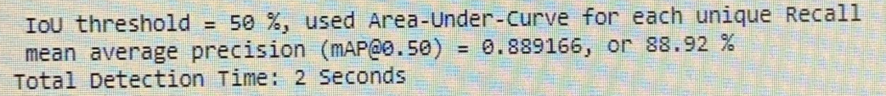
MODEL EVALUATION
Satisfactory results by the model trained over 150 epoch
Challenges: Low resolution input, complicated images, reverse lights,
computation power
35th epoch - evaluation
150th epoch - evaluation
<number>

Slide 15
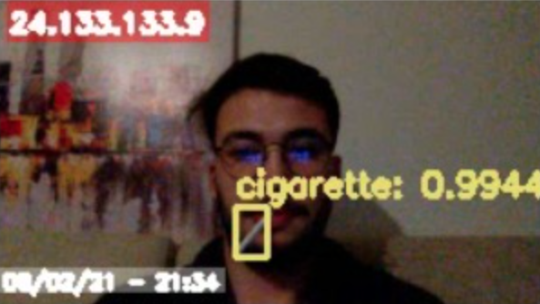
DEPLOYMENT of the TRAINED MODEL
Deploying the trained YOLOv3 GPU-supported OpenCV on Python.
All server operations in only and one Python script
TCP Socket Host
Image transfer
Object detection and image processing
Uploading outputs to Google Cloud Storage
<number>

Slide 16
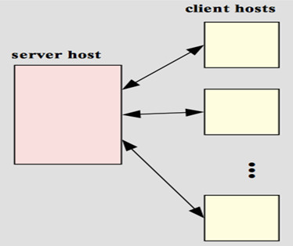
IMAGE TRANSFER
Image transfer was made over TCP/IP protocol with Client-Server architecture.
Client - Server architecture has 3 important components:
Clients
Servers
Communication Networks

Slide 17
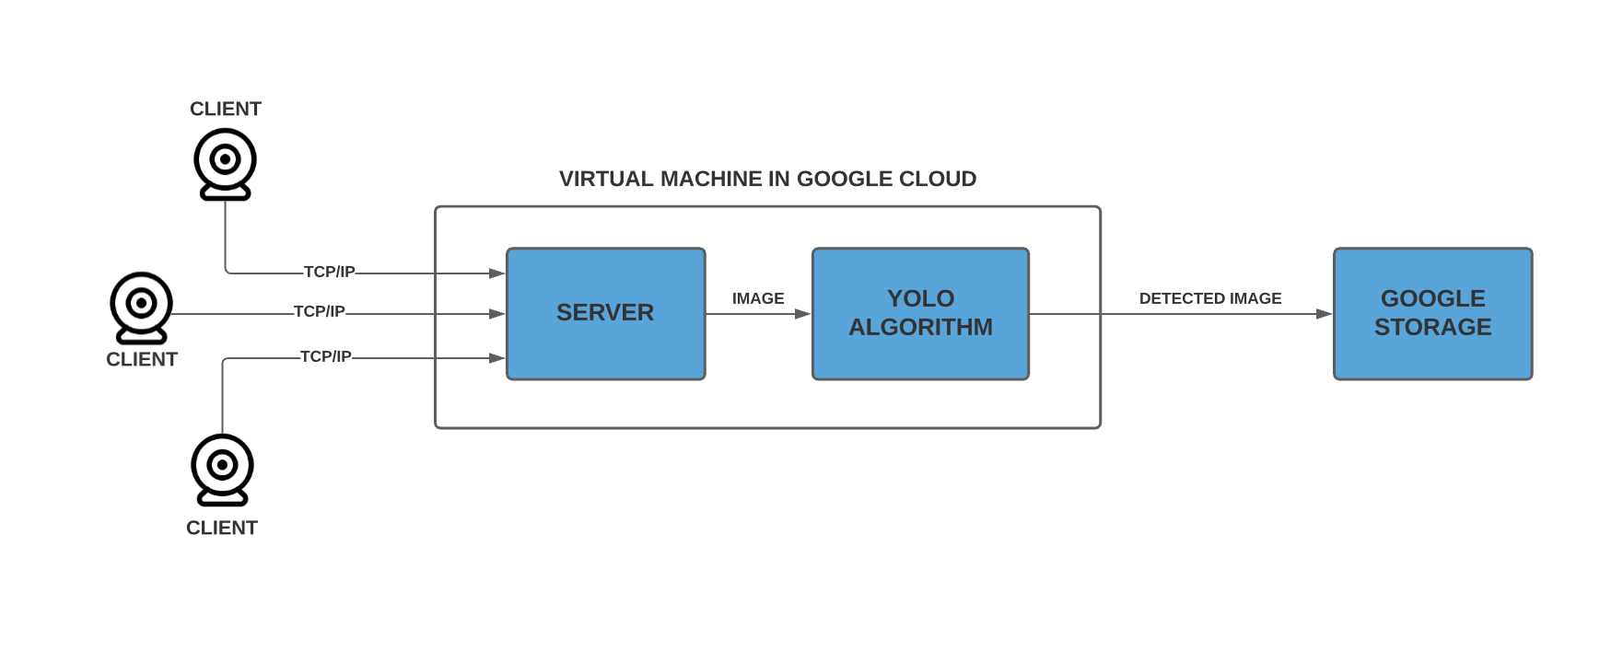
CLIENT-SERVER ARCHITECTURE
Server, algorithm and Google Storage connection codes are running on the virtual machine opened via Google Compute Engine.

Slide 18
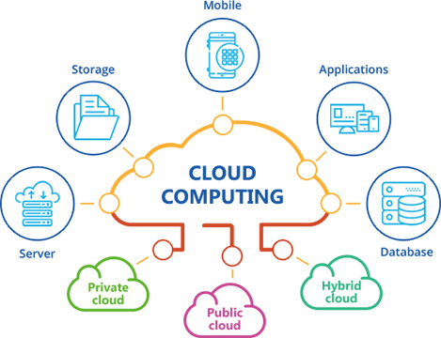
CLOUD COMPUTING
Cloud technologies were used to our project in real time and effectively.
Google Cloud from Cloud Services was used.
Object detection algorithm trained on the Cloud.
Prepared algorithms were run on virtual machines.

Slide 19


GOOGLE COLABORATORY
Google Colaboratory (or "Colab" for short) allows you to write and run Python in the browser.
No configuration required
Offers free access to GPUs
Offers easy sharing
Considering these advantages, the object detection algorithm has been trained on the Google Colab platform.

Slide 20
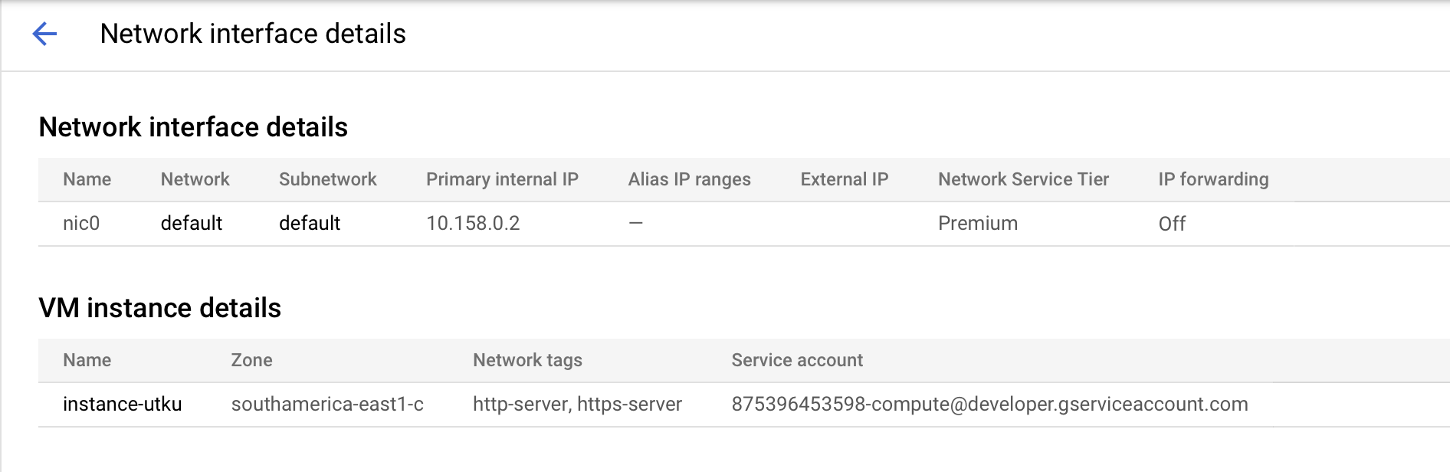
GOOGLE COMPUTE ENGINE
A virtual machine was created on the Google Compute Engine platform.
Used 8 vCPUs, 30 GB memory.
Firewall settings made for image transfer.
Network details of the virtual machine are as follows.

Slide 21
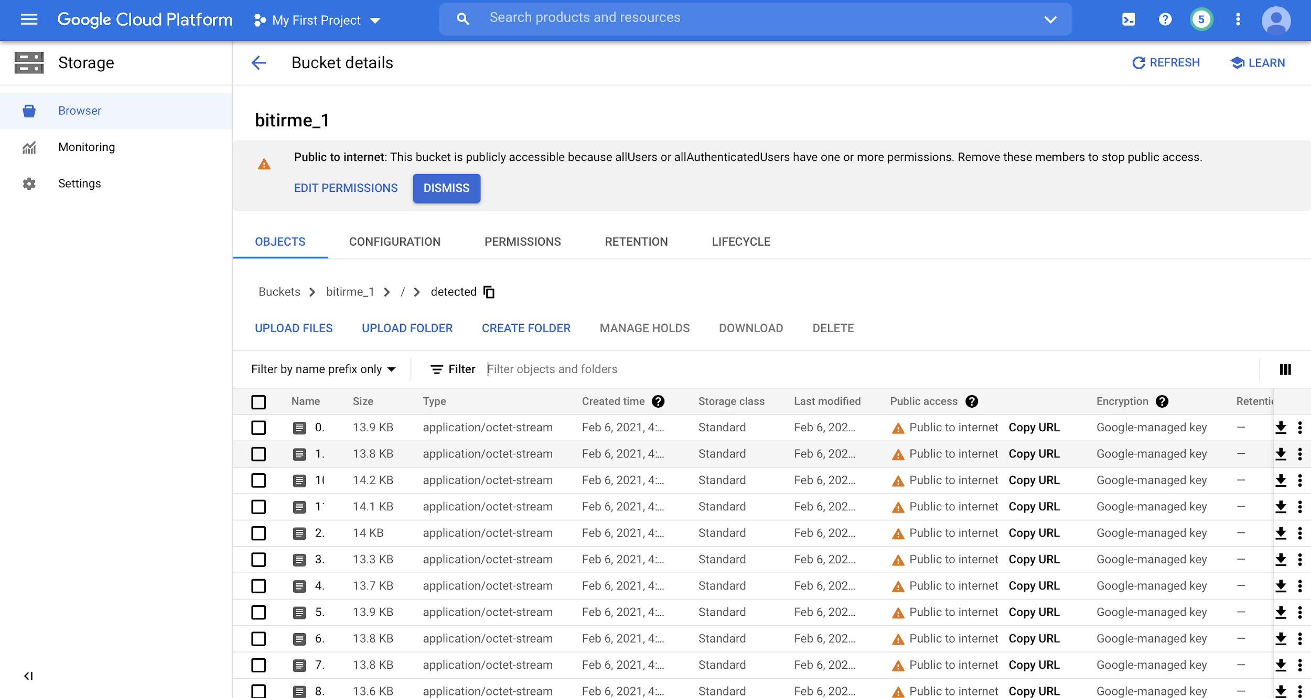
GOOGLE STORAGE SERVICE
Detected images are automatically transferred to the Google Storage.
Google Storage service is used as database in the Project
Detected images are stored with metadata.

Slide 22

WEB SERVER
Node.js
JavaScript runtime built on Chrome’s V8 JavaScript engine
Open source server environment
Designed to build scalable network applications

Slide 23

WEB SERVER
React
JavaScript library for building user interfaces
JSX and virtual DOM

Slide 24
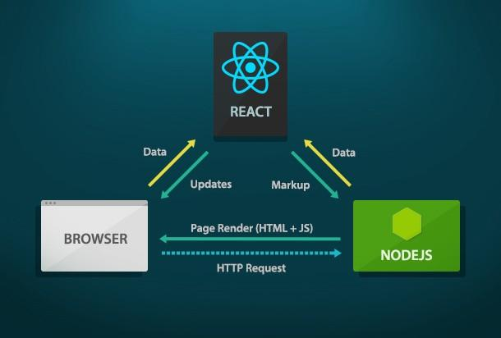
WEB SERVER
Application
Use Node.js as backend and React as a frontend
Communication between Node.js and React
Use Node.js for metadata

Slide 25
WEB SERVER
Application
Use React for displaying the detecting frames
Get metadata information from Node.js
Use React for displaying the details for each frame

Slide 26
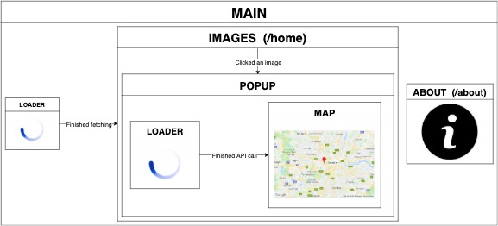
WEB SERVER
Components
Loader, Map, Images, Popup, Main and About components

Slide 27

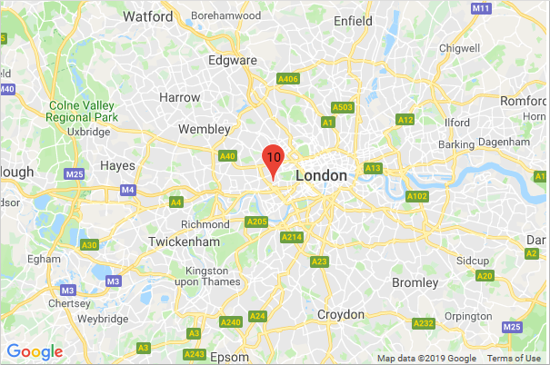
WEB SERVER
Loader and Map
Loader uses a component with type, color, size and timeout
Map uses Google Map package with authentication key

Slide 28
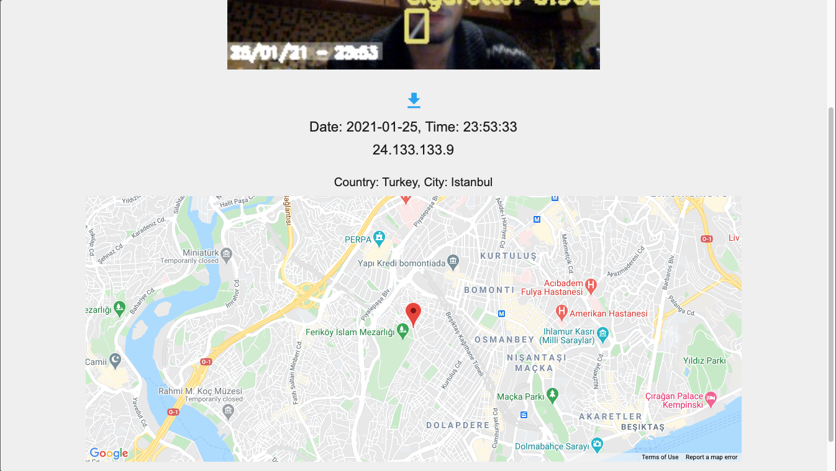
WEB SERVER
Popup
Includes image, date, time, IP, location and map information
Uses the Map component and IP to location API

Slide 29
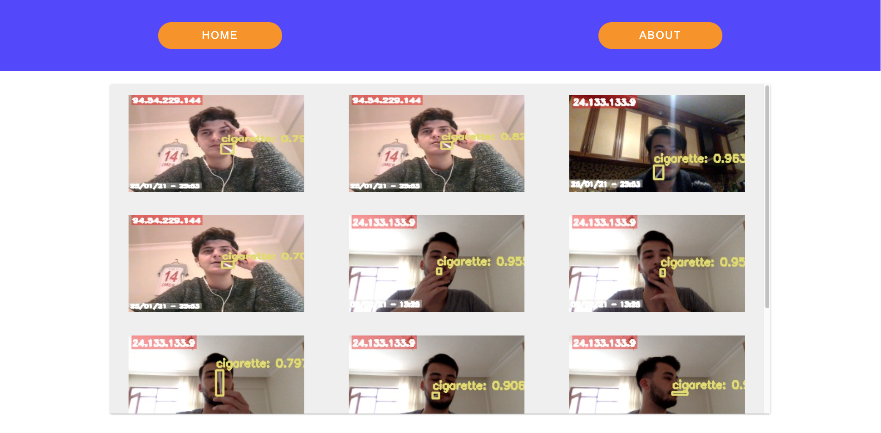
WEB SERVER
Images
Images in a responsive designed Material UI component

Slide 30
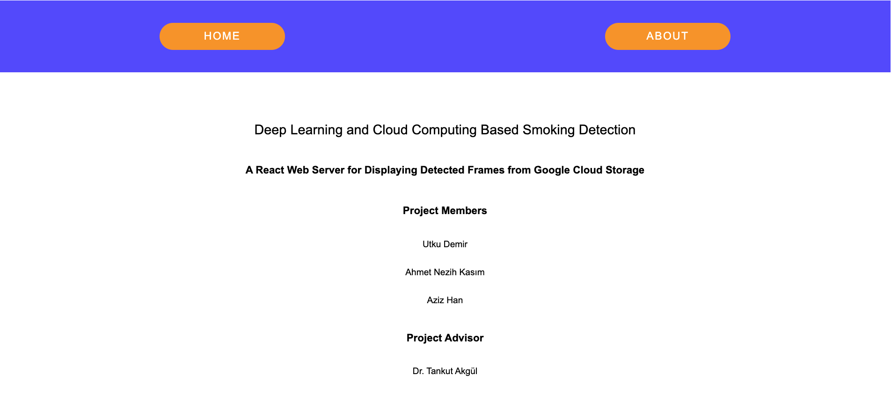
WEB SERVER
About
Includes the project information, members and advisor

Slide 31
THANK YOU FOR LISTENING!

